Slide 1
TikTok account analysis

Slide 2
Questions
What have the results been for posting videos between 14h00 - 14h30 CAT?
Do memes work better than highlights of normal(don't produce, have no presence) DJ's?
Did combining DJ's and memes work?
Why are the memes working?
What is the best performing video and what clues do we get regarding the TikTok algorithm?

Slide 3
Data Collected
I collected 60 days worth of data generated on a single account, based on my experience on Creating HypeCrew Entertainment, the questions were formulated and answered.
The data itself is from the Analytics of the best performing video and the dashboard is generated based on the Overall performance of the Tiktok personal account.

Slide 4
PowerBI Dashboard
Tiktok performance dashboard.pbix

Slide 5
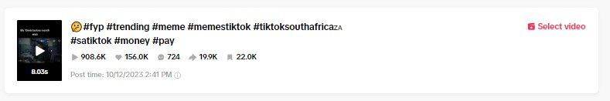
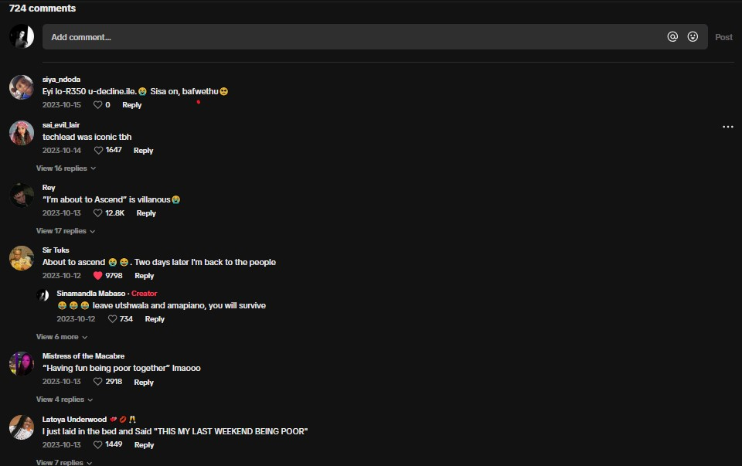
Best performing video insights

Slide 6
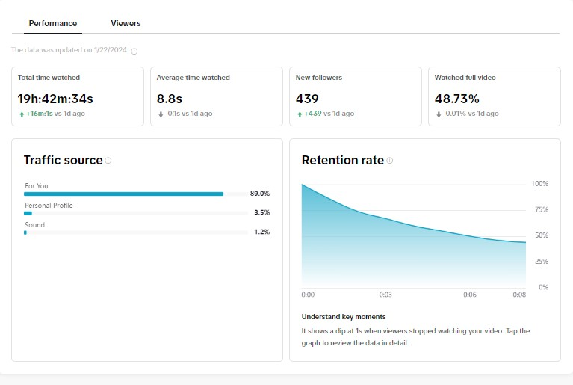

Slide 7
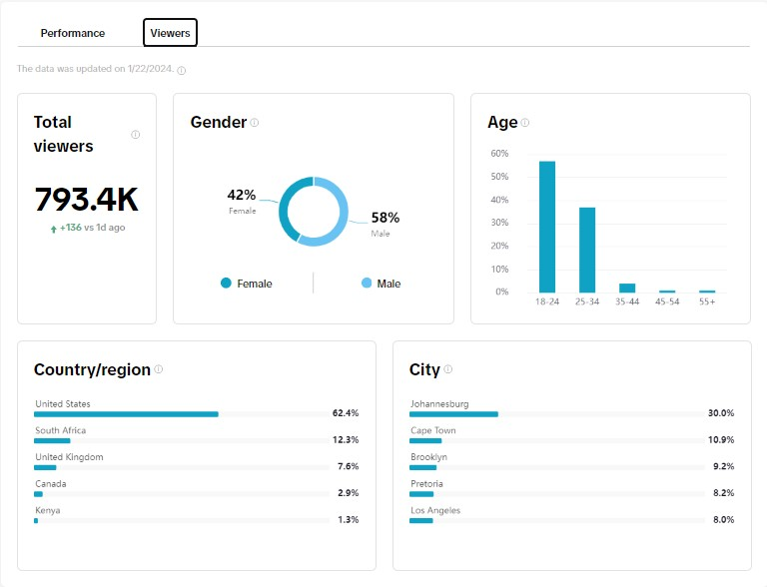

Slide 8
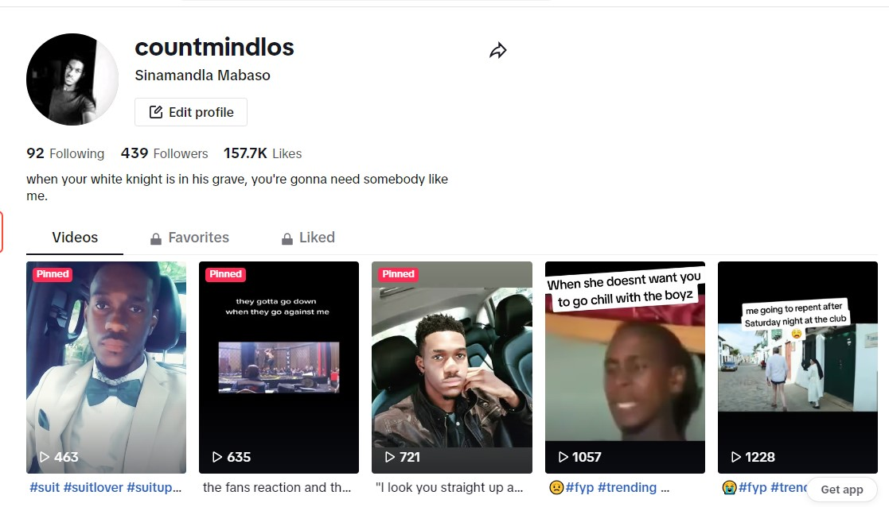
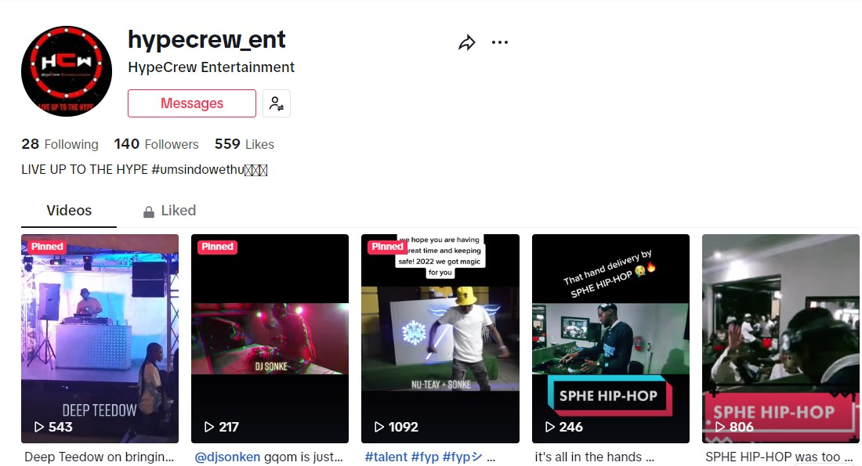
TikTok account comparison

Slide 9
Conclusion
Based on the findings in the data, the Tiktok algorithm is influenced mainly by Comments, Shares and likes. The comments that really tend to get responds or reaction out of people is centered around the topic of “money” and the punchline delivered by each meme type video should be very quick hence the best performing video is 8s and the video is straight to the point exactly at 3s in.
Posting DJs playing music tends to be tricky because the music itself is a very preference based topic, and people want what they want. Even though they are made into memes, they still do not gain as much traction because the DJ themselves have to be well known.
On average between 14h00 and 15h00 I have seen the video go to about 500 views in 20minutes using #Fyp and #trending. And from 16h30 it doubles.

